Slide 1

Welcome to
Year 5
‘Meet the Teacher’
Monday13th July 2026

Slide 2




The staff
Mrs Martin
Mrs Filmer
Mrs Wheater (PPA release cover)

Slide 3


Key dates
TERM 1 sessions
Every TUESDAY and THURSDAY
First day back – Wednesday 2th September
Swimming - TBC, hopefully Term 2
CAT4 Assessments to inform Kent Test Applications
Date to be confirmed (Term 3)
These are a series of tests designed to assess a student's reasoning abilities in four key areas: verbal reasoning, non-verbal reasoning, quantitative reasoning, and spatial ability. These tests are used by schools to understand a student's learning style, academic potential, and to inform teaching strategies
PESE Transfer Parent Meetings
May/June 2027 – dates to be confirmed.

Slide 4
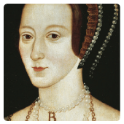
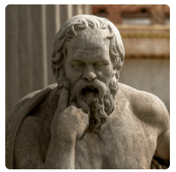

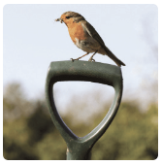
Curriculum Coverage
There is a copy of the curriculum coverage on the school website
https://lenham.kent.sch.uk/our-classes/year-5/
Off With Her Head
Ground-breaking Greeks
Allotment

Slide 5
Homework –
Maths and English
We will begin setting homework once the children have settled in to Year 5. Set weekly using CGP homework books. Children to be responsible for looking after these books.
Spelling
Weekly spellings are taught in school sessions. Spellings are tested in class every Friday. Spelling Shed should be used to practise spellings.
Times Tables
Maintaining good levels of recall is necessary to support the level of maths covered in Year 5. Access Times Tables Rock Stars regularly.
Reading
Every child should read for 20 minutes every day. These reading sessions should be recorded in the Reading record and regularly signed by an adult.

Slide 6

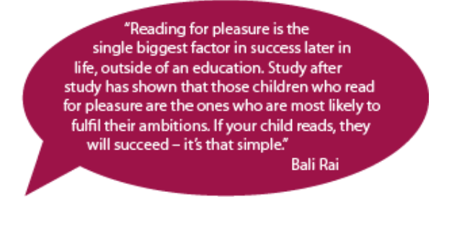
Reading
We cannot stress enough the importance of developing your child’s ability and love of reading.
Fluent and confident readers become confident and fluent writers.
Those who can read with confidence can access the increasing demands of the Upper KS2 curriculum.

Slide 7
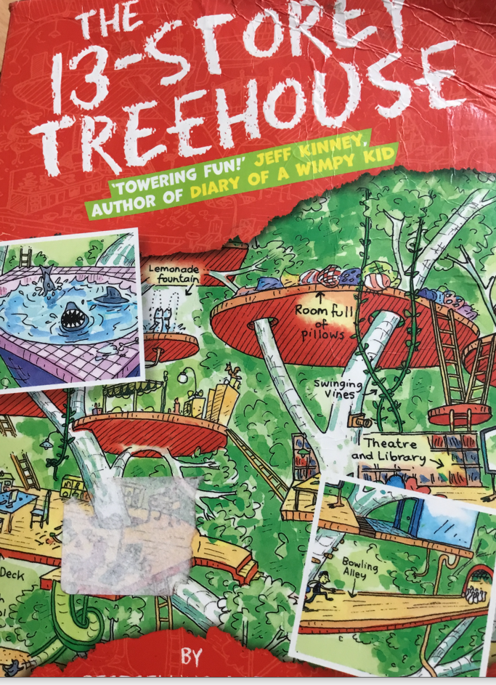

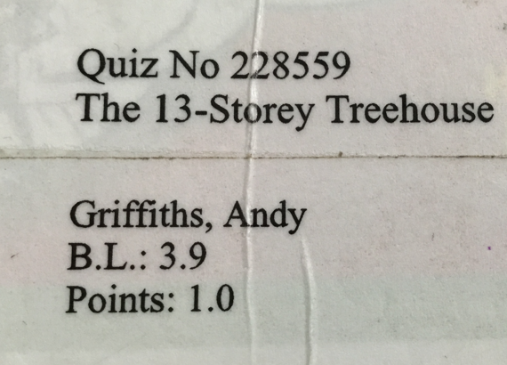
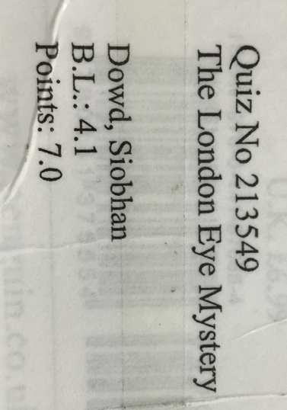
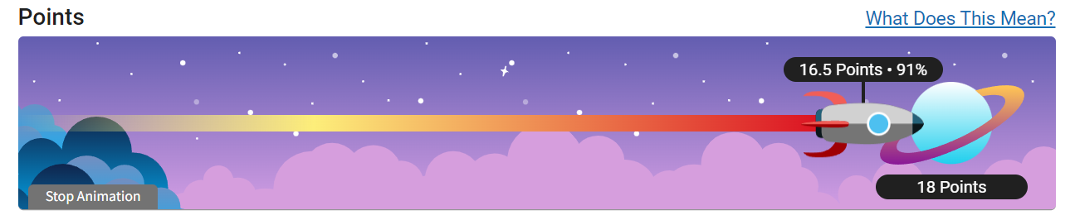

Each term, the children are given a reading target
(e.g. 12 points). To reach this target, they need to read a number of books and pass the quiz for each book. For each quiz that they pass, they will be awarded points. The children can use Accelerated Reader to track their progress.

Slide 8
Each child has a reading target tailored to their ability
Targets are based on the child’s reading ability, speed and comprehension ability (this is measured termly through a STAR test completed in class)
Targets are calculated based on your child reading for 35 minutes each day. 15 minutes of class times is devoted to reading each day; the further 20 minutes (minimum) is to be done at home (in line with our homework policy).

Slide 9
Does my child have to read independently at home?
NO - reading can be collaborative
They might like to read to you/you to read to them
They might enjoy listening to an audiobook
Most importantly DISCUSS their book with them, what's happening/can they make predictions/can they give their opinion on the plot or characters.
Comprehension skills are VITAL for Year 5 reading success.

Slide 10

Year 5 key information
Y5 page of Website
Events will be posted on the Y5 page of website. It is a key way keeping up to date. It will give include details of any homework set.
Swimming
Year 5 will be completing the statutory swimming sessions (tbc, hopefully in Term 2).
PE Kits
NAMED clothing required. Please ensure it is appropriate for the weather conditions as lessons will be indoors and outdoors. Correct footwear is required.
Pencil Cases
A pencil case containing the essential stationery items are provided. NO OTHER pencil cases are necessary.
Water Bottles
Children have access to their bottles during the day.
Wellies
We try and use the field as much as possible across the year, so a named pair of wellies is essential.

Slide 11
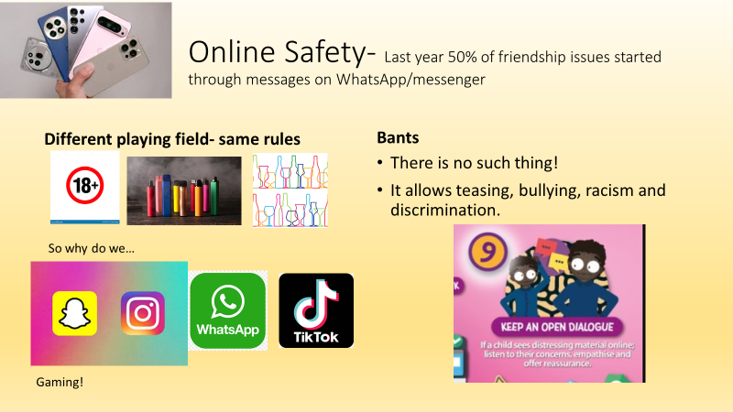
Please consider whether your child is ready for a phone and whether a smart phone is the correct choice.

