Slide 1

‘Meet the Teacher’
July 2026

Slide 2
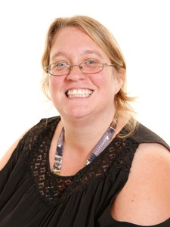
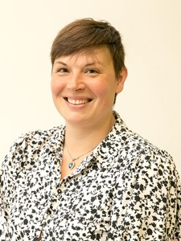
Year 2 Staff
Mrs Horlock
Mrs Carter

Slide 3

TERM 1 sessions
Every Tuesday and Thursday
Please ensure your child has their PE kit on these days and any earrings taken out.
Name everything!

Slide 4
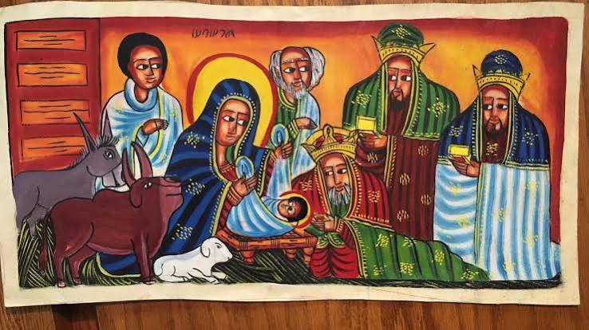
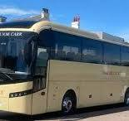
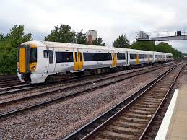
Key Events
Nativity – Early December
School trip - date and venue to be confirmed but will most likely be in the spring term
Big Summer Sing and Dance
- June or July (6th term)

Slide 5



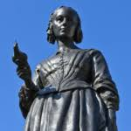
Curriculum Coverage
There is a copy of the curriculum coverage on the school website
https://lenham.kent.sch.uk/our-classes/year-2/
The main curriculum projects are as follows;
Land Ahoy!
Magnificent Monarchs
Movers and Shakers

Slide 6




Homework – makes a HUGE difference to every child!
Homework folders
We ease them into completing homework (to become ready for KS2) by starting with alternating between a Maths task or an English task. Your child completes it first and you can check it afterwards, discussing with them any errors. This will increase with difficulty and amount as the year progresses. Return to school by the Wednesday.
Reading
Every child should read for at least 10 minutes every day. These reading sessions should be recorded in the reading record by an adult each day. This makes a big difference to your child as reading is needed in every subject.
NumBots
Regular practise of number facts is completed by accessing Numbots. Each child is supplied with a login, the details are in their Reading Record so that they can access it at home via a free app. Minimum 20 minutes a week.
Edshed
Regular practise of spelling rules which will make a huge difference to their spelling ability. Login details are in their Reading Record and is accessed via www.edshed.com. Minimum 20 minutes a week.

Slide 7
Year 2 key information
Weekly Bulletin - It is important that you keep up to date with upcoming events in school.
Class news - Check out our class page on the website, it informs you about the next week's learning, gives you guidance on any homework activities, tells you whose show and tell week it is and gives you infinity codes for maths support.
Wellies - We try and use the field as much as possible across the year, so a named pair of wellies in a bag is essential to have in school.
Change of clothes - Keeping a simple change of essential clothing items in your child’s bag is always welcome just in case they have an accident at school - named!
Water Bottles - A sip top water bottle is recommended for use in school as this prevents spillage. It is recommended that you get a soft plastic or metal one. Hard plastic breaks! Please make sure they are clearly named.
Pencil case - One smallish sized pencil case is allowed – no calculators! They can bring their own writing pencil, multi-colour biro, purple biro, rubber, ruler, colouring pencils and felt tip pens (although those are used less often). NAMED!
NAME EVERYTHING! Uniform, PE kit, coats, shoes, bottles – everything. “The one without a name” is not helpful.

Slide 8






Read together
Reading is key to every aspect of your child's learning. Try to listen to your child read every day. It really does make a huge difference to their academic abilities plus it’s a nice bonding time.
Communication
Please communicate with me about any concerns or issues your child or you may have, you can write in the contact book or email the office. Your child’s well-being is a priority but if I don’t know – I can’t help them.
Healthy habits
Sleep, diet and well-being are critical to your child being able to focus during lessons.
Homework
Set aside time for your child to do any homework including reading – a great opportunity to sit and chat about their week. There is a very clear link between those at expected or above and those who do their homework and who read regularly.

Slide 9


