Slide 1
Welcome to Year 1
‘Meet the Teacher’ Monday 11th July 2022

Slide 2
The staff
Mrs Horlock
Mrs Humberson – covering PPA sessions
Mr Lusted and Miss Ward

Slide 3
Key dates
TERM 1 sessions
Every MONDAY and WEDNESDAY
5th September – back to school
Term 2 - Nativity
Term 5 – School trip
w/c 10th June 2023
Phonics Screening for Year 1 pupils
Remove earrings or cover with tape.

Slide 4
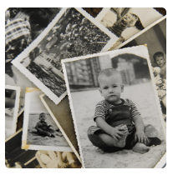
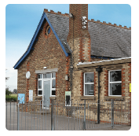
Curriculum Coverage
There is a copy of the curriculum coverage on the school website
https://lenham.kent.sch.uk/our-classes/year-1/
The main curriculum projects are as follows;
Childhood
Bright Lights, Big City
We will learn about everyday life and families today, including comparisons with childhood in the 1950s+.
We will learn about the physical and human characteristics of the United Kingdom; as well as learning about the Great Fire of London.
School Days
We will learn about the primary school and its locality, both today and in the past. Comparing Victorian schooling to our own experiences.

Slide 5
Changing from EYFS to Year One.
Gradual increases in learning time.
No Tapestry
Phonics scheme – Little Wandle
Tapestry is only used in Rainbow Class so please read the newsletters and note down any dates. You can still share home events but by sending in photos for your child to share during show and tell. Year 1 webpage is updated each week and informs you about the week’s learning.
Continues from Reception class – books are changed on a Friday. They then keep these books, for the week. At school, they will have a new book. They read this three times, to an adult, covering word reading, prosody and comprehension before bringing it home. They are assessed at the end of each term – this determines their level, we stick to this as it is about fluency and comprehension more than just decoding words.

Slide 6
Read together
Reading is key to every aspect of your child's learning. Try to listen to your child read or share a book with them every day.
Homework
Set aside time for your child to do any homework – a great opportunity to sit and chat about their week.
Healthy habits
Sleep, diet and well-being are critical to your child being able to focus in class.
Communication
Please communicate with me about any concerns or issues your child or you may have, you can write in the contact book or email the office.

Slide 7
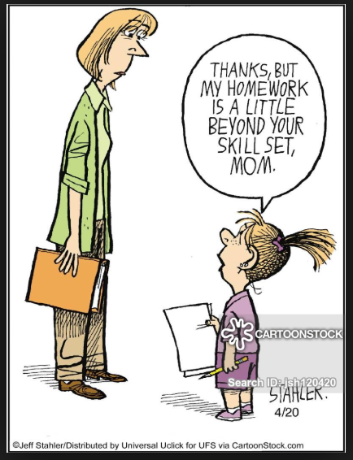
Homework –
Reading (when the books are sorted)
Every child should read for 15 minutes every day. These reading sessions should be recorded in the Reading record and signed by an adult each day.
Number Bonds
Regular practise of number facts should be completed using Numbots. Each child is supplied with a login and details will be placed in their Reading Record.
Handwriting/ Literacy/ Maths
Additional homework opportunities are listed on the Year 1 webpage, they do change throughout the year to match the learning. Any work completed at home, please send in for your child to show and receive housepoints.

Slide 8
Year 1 key information
Weekly News
It is really important that you keep up to date with events in class and the Weekly News is a key way of doing this. It is published on the school website every Friday. It will give details of any homework set.
Wellies
We try and use the field as much as possible across the year, so a NAMED pair of wellies is essential.
Change of clothes
Keeping a simple change of essential clothing items in your child’s PE bag is always welcome, just in case they have an accident at school. Please include a winter PE kit and trainers.
Name everything!
Water Bottles
A sip top water bottle is recommended for use in school. Please make sure they are clearly named. Harder plastic bottles break! Use soft flexible plastic bottles or metal with a flip top not screw top.

