Slide 1
Welcome to Year 6
‘Meet the Teacher’
Thursday 13th July 2023

Slide 2
The staff
Mrs Fisher
Mrs Prescott (Mr Flood)
Working across Year 5 and 6 supporting in all areas

Slide 3
Key dates
Friday 1st September 2023
Applications for Secondary Transfer open
Thursday 7th September 2023
Kent Test Day
(for those who have applied)
Wednesday 18th October 2023
Kent Test Results to parents
Tuesday 31st October 2023
Secondary Transfer Applications close
Friday 1st March 2024
National Offer Day
Monday 2nd October
Bowles Residential information meeting at 3.20pm
Monday 4th December
Magistrates Workshop
Monday 13th –Thursday 16th May 2024
KS2 SATs Week
Wednesday 10th – Friday 12th July 2024
Bowles Residential

Slide 4
Curriculum Coverage
There is a copy of the curriculum coverage on the school website
https://lenham.kent.sch.uk/our-classes/year-6/
The main curriculum projects are as follows;
Britain at War
Frozen Kingdom
Maafa

Slide 5
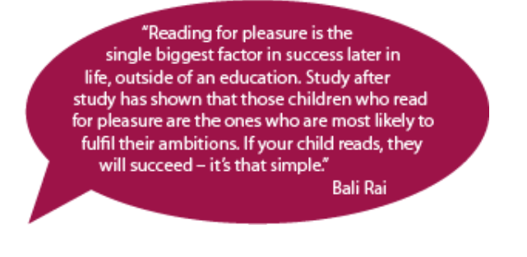
Reading We cannot stress enough the importance of developing your child’s ability and love of reading. How your child can access our curriculum depends on them being a fluent and confident reader.

Slide 6
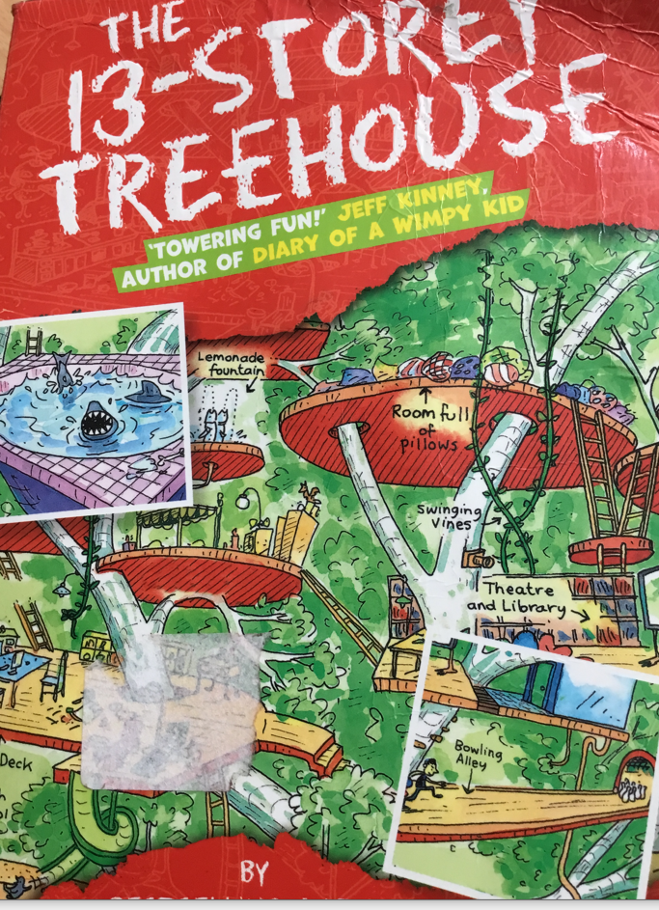
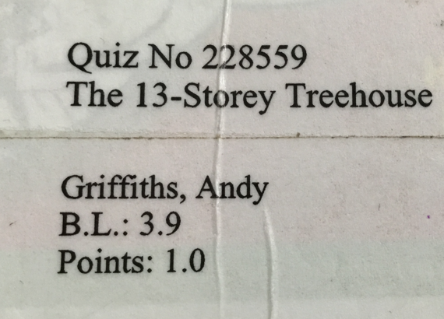
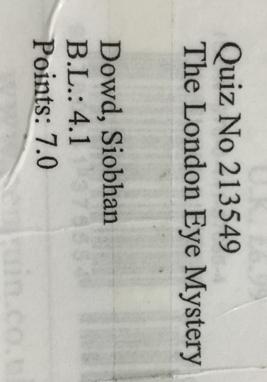
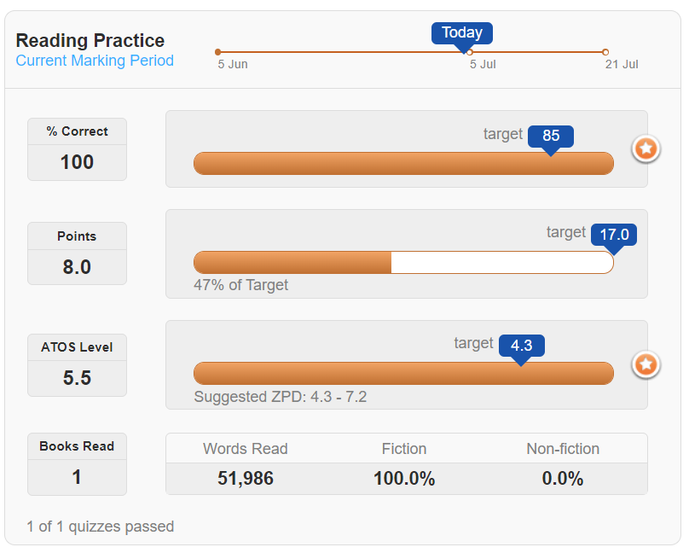
Each term, the children are given a reading target (e.g. 12 points). To reach this target, they need to read a number of books and pass the quiz for each book. For each quiz that they pass, they will be awarded points. The children can use Accelerated Reader to track their progress.

Slide 7
Each child has a reading target tailored to their ability
Targets are based on the child’s reading ability, speed and comprehension ability (this is measured through a STAR test completed in class).
Targets are calculated based on your child reading for 35 minutes each day. 15 minutes of class time is devoted to reading each day; the further 20 minutes (minimum) is to be done at home (in line with our homework policy).

Slide 8
How we promote reading in class
We have a dedicated session of reading every day in class.
Children who pass their reading quizzes (by achieving 80% or more), get to enjoy their next reading session in our reading corner.
Children who achieve their termly target receive a treat at the end of that term!

Slide 9
Does my child have to read independently at home?
They might like to read to you
They might like to share the reading with you
They might like you to read to them
They might enjoy listening to an audiobook
All of the above will improve your child’s reading confidence and fluency, and will positively impact their learning in other areas of the curriculum.

Slide 10
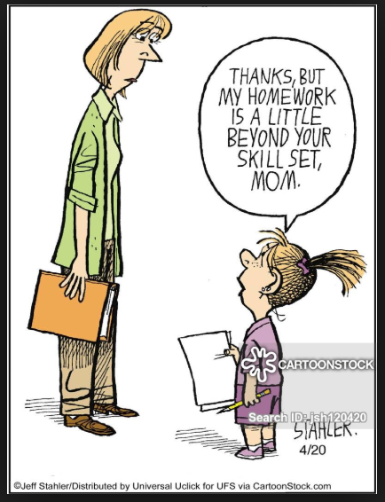
Homework
Maths and English
Homework booklets for Maths, SPAG and Reading. Pages from two booklets set per week.
Reading
Every child should read for 20 minutes every day. These reading sessions should be recorded in the Reading Record and regularly signed by an adult.
Spelling
The learning weekly spellings is covered in school sessions. Spelling lists posted on the Class page each week and loaded onto Ed Shed.
Times Tables
Maintaining good levels of recall is highly recommended to support the level of maths covered in Year 6.

Slide 11
Year 6 key information
Weekly News
It is really important that you keep up to date with events in class and the Weekly News is a key way of doing this. It is published on the class page on the school website every Friday. It will give details of any homework set and important dates.
SAT preparation
We will be testing regularly during the year. This is intended to reduce exam stress in May as the children become familiar with the process.
School Trips
During Term 2, we will be making a trip to a local venue to support our WW2 project. We aim to ensure the cost of the trip is approximately £22 per child. More details will be sent out during start of Term 1.
During Term 6, Year 6 also take part in Safety in Action. The cost should be £10.
Swimming
This will take place on a Thursday afternoon during Term 6.

Slide 12
Year 6 key information
Hoodies
Details will be sent home during Term 2.
PE Kits
As lessons are held throughout the year, both indoors and outdoors please make sure that clothing is appropriate for the weather conditions.
Pencil Cases
A pencil case containing the essential stationery items are welcome in class.
Water Bottles
Children have access to their bottles on their table.
Wellies
We try and use the field as much as possible across the year, so a named pair of wellies is essential.

Slide 13
Online Safety
A range of easy-to-read parent guides can be found on the school website.
https://lenham.kent.sch.uk/parent-info/online-safety/

Slide 14
Dismissal at the end of the school day
During term 1, we will send home a yellow letter regarding walking home at the end of the school day.
There is a section on the form about bringing in a mobile phone – these must be switch off and are kept in a box for safe keeping each day.
Children will only be able to walk home at 3.15pm on the days indicated by parents on the form and during Terms 1 – 4 will still need to be collected at the end of after school clubs.

